Slide 1
Linked List

Slide 2
Linked List
Linked List can be defined as collection of objects called nodes that are randomly stored in the memory.
A node contains two fields i.e. data stored at that particular address and the pointer which contains the address of the next node in the memory.
The last node of the list contains pointer to the null.

Slide 3
Uses of Linked List
The list is not required to be contiguously present in the memory. The node can reside any where in the memory and linked together to make a list. This achieves optimized utilization of space.
list size is limited to the memory size and doesn't need to be declared in advance.
Empty node can not be present in the linked list.
We can store values of primitive types or objects in the singly linked list.

Slide 4
Why use linked list over array?
Array contains following limitations:
The size of array must be known in advance before using it in the program.
Increasing size of the array is a time taking process. It is almost impossible to expand the size of the array at run time.
All the elements in the array need to be contiguously stored in the memory. Inserting any element in the array needs shifting of all its predecessors.

Slide 5
Continue…
Linked list is the data structure which can overcome all the limitations of an array. Using linked list is useful because,
It allocates the memory dynamically. All the nodes of linked list are non-contiguously stored in the memory and linked together with the help of pointers.
Sizing is no longer a problem since we do not need to define its size at the time of declaration. List grows as per the program's demand and limited to the available memory space.

Slide 6
Complexity
Data Structure | Time Complexity |  |  |  |  |  |  |  | Space Compleity
 | Average |  |  |  | Worst |  |  |  | Worst
 | Access | Search | Insertion | Deletion | Access | Search | Insertion | Deletion
Singly Linked List | θ(n) | θ(n) | θ(1) | θ(1) | O(n) | O(n) | O(1) | O(1) | O(n)

Slide 7
Operations on Singly Linked List
Node Creation
struct node
{
int data;
struct node *next;
};
struct node *head, *ptr;
ptr = (struct node *)malloc(sizeof(struct node *));

Slide 8
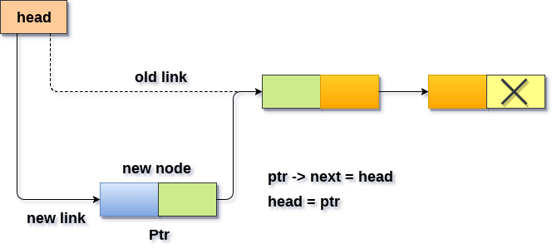
Insertion
Insertion in singly linked list at beginning
Algorithm
Step 1: IF PTR = NULL
Write OVERFLOW Go to Step 7 [END OF IF]
Step 2: SET NEW_NODE = PTR
Step 3: SET PTR = PTR → NEXT
Step 4: SET NEW_NODE → DATA = VAL
Step 5: SET NEW_NODE → NEXT = HEAD
Step 6: SET HEAD = NEW_NODE
Step 7: EXIT

Slide 9
#include<stdio.h>
#include<stdlib.h>
void beginsert(int);
struct node
{
int data;
struct node *next;
};
struct node *head;
void beginsert(int item)
{
struct node *ptr = (struct node *)malloc(sizeof(struct node *));
if(ptr == NULL)
{
printf("\nOVERFLOW\n");
}
else
{
ptr->data = item;
ptr->next = head;
head = ptr;
printf("\nNode inserted\n");
}
}
void main ()
{
int choice,item;
do
{
printf("\nEnter the item which you want to insert?\n");
scanf("%d",&item);
beginsert(item);
printf("\nPress 0 to insert more ?\n");
scanf("%d",&choice);
}while(choice == 0);
}

Slide 10
Insertion in singly linked list at the end
In order to insert a node at the last, there are two following scenarios which need to be mentioned.
The node is being added to an empty list
The node is being added to the end of the linked list

Slide 11
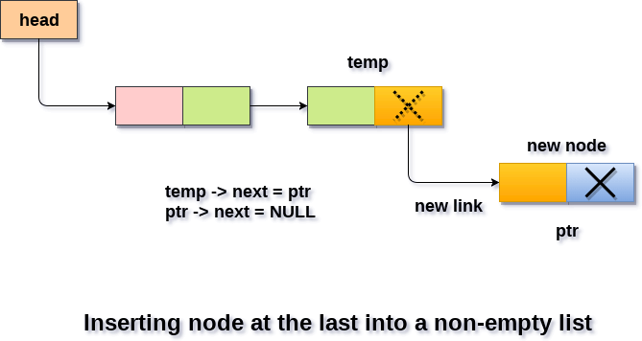
Algorithm
Step1: IF PTR = NULL Write OVERFLOW Go to Step 1 [END OF IF]
Step 2: SET NEW_NODE = PTR
Step 3: SET PTR = PTR - > NEXT
Step 4: SET NEW_NODE - > DATA = VAL
Step 5: SET NEW_NODE - > NEXT = NULL
Step 6: SET PTR = HEAD
Step 7: Repeat Step 8 while PTR - > NEXT != NULL
Step 8: SET PTR = PTR - > NEXT [END OF LOOP]
Step 9: SET PTR - > NEXT = NEW_NODE
Step 10: EXIT

Slide 12
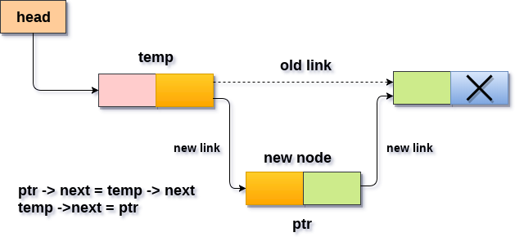
Insertion in singly linked list after specified Node
Algorithm
STEP 1: IF PTR = NULL
WRITE OVERFLOW GOTO STEP 12 END OF IF
STEP 2: SET NEW_NODE = PTR
STEP 3: NEW_NODE → DATA = VAL
STEP 4: SET TEMP = HEAD
STEP 5: SET I = 0
STEP 6: REPEAT STEP 5 AND 6 UNTIL I
STEP 7: TEMP = TEMP → NEXT
STEP 8: IF TEMP = NULL
WRITE "DESIRED NODE NOT PRESENT" GOTO STEP 12 END OF IF END OF LOOP
STEP 9: PTR → NEXT = TEMP → NEXT
STEP 10: TEMP → NEXT = PTR
STEP 11: SET PTR = NEW_NODE
STEP 12: EXIT

Slide 13
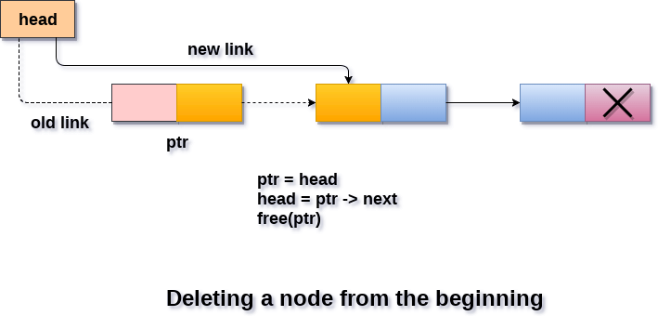
Deletion and Traversing
Deletion in singly linked list at beginning
Algorithm
Step 1: IF HEAD = NULL
Write UNDERFLOW Go to Step 5 [END OF IF]
Step 2: SET PTR = HEAD
Step 3: SET HEAD = HEAD -> NEXT
Step 4: FREE PTR
Step 5: EXIT

Slide 14
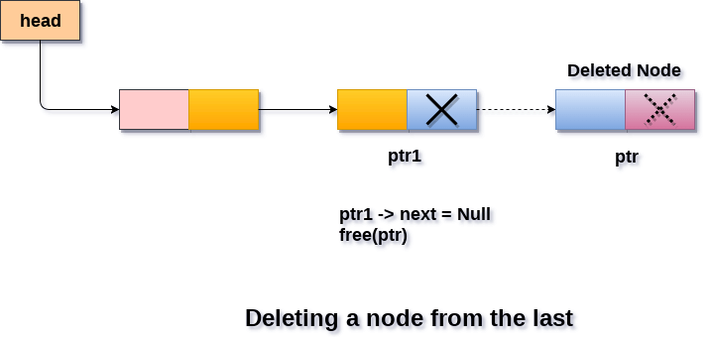
Deletion in singly linked list at the end
Algorithm
Step 1: IF HEAD = NULL
Write UNDERFLOW Go to Step 8 [END OF IF]
Step 2: SET PTR = HEAD
Step 3: Repeat Steps 4 and 5 while PTR -> NEXT!= NULL
Step 4: SET PREPTR = PTR
Step 5: SET PTR = PTR -> NEXT
[END OF LOOP]
Step 6: SET PREPTR -> NEXT = NULL
Step 7: FREE PTR
Step 8: EXIT

Slide 15
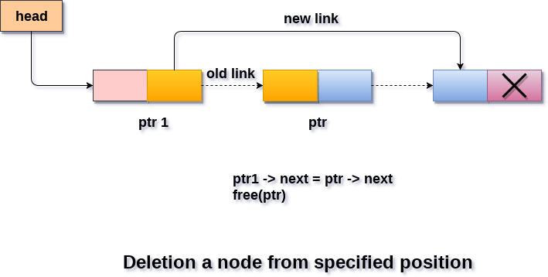
Deletion in singly linked list after the specified node :
Algorithm
STEP 1: IF HEAD = NULL
WRITE UNDERFLOW GOTO STEP 10 END OF IF
STEP 2: SET TEMP = HEAD
STEP 3: SET I = 0
STEP 4: REPEAT STEP 5 TO 8 UNTIL I
STEP 5: TEMP1 = TEMP
STEP 6: TEMP = TEMP → NEXT
STEP 7: IF TEMP = NULL
WRITE "DESIRED NODE NOT PRESENT" GOTO STEP 12 END OF IF
STEP 8: I = I+1
END OF LOOP
STEP 9: TEMP1 → NEXT = TEMP → NEXT
STEP 10: FREE TEMP
STEP 11: EXIT

Slide 16
Traversing in singly linked list
Algorithm
STEP 1: SET PTR = HEAD
STEP 2: IF PTR = NULL
WRITE "EMPTY LIST" GOTO STEP 7 END OF IF
STEP 4: REPEAT STEP 5 AND 6 UNTIL PTR != NULL
STEP 5: PRINT PTR→ DATA
STEP 6: PTR = PTR → NEXT
[END OF LOOP]
STEP 7: EXIT

Slide 17
Searching in singly linked list
Algorithm
Step 1: SET PTR = HEAD
Step 2: Set I = 0
STEP 3: IF PTR = NULL
WRITE "EMPTY LIST" GOTO STEP 8 END OF IF
STEP 4: REPEAT STEP 5 TO 7 UNTIL PTR != NULL
STEP 5: if ptr → data = item
write i+1 End of IF
STEP 6: I = I + 1
STEP 7: PTR = PTR → NEXT
[END OF LOOP]
STEP 8: EXIT

